Slide 1
Progress Report
8/12
HJ. Kwon
Progress Report
NCC-GCSP

Slide 2
확인필요사항
70’s-80+ 연령층 통합 V
HBV population percentage 낮음 , Antiviral Drug, HBsAG 검사 통해서 추가 capture 필요 ..ing
Others에 대한 내역 확인 필요 V
체중의 경우 persistently underweight, increasing weight, decreasing weight, persistently overweight 로 분리 가능, but 들이는 시간에 비해서 효과 미비할 수 있음
FLI의 경우 HBV, HCV, Alcohol 등의 population을 제외하는 것이 맞으나, whole population에 적용하여 산출하는 것이 더 이득이 높을 것
hepatic steatosis index ..ing
HJ. Kwon
Progress Report
NCC-GCSP

Slide 3
Antiviral Drug Effect
HJ. Kwon
Progress Report
NCC-GCSP

Slide 4
약제코드
HBsAG
T30(진료내역) + 처방전교부상세(T60)
→ 분류코드(MCARE_DIV_CD_ADJ)
일반 1차 → B형 간염 항원 보유자(Q_HBV_AG)
간암검진 → B형간염 검사결과 (CLV_HPTB_RST)
→ 확인필요
HJ. Kwon
Progress Report
NCC-GCSP

Slide 5
분류코드
Medicine Ingredient | ATC | Check
Ribavirin | J05AP01 | HCV
Boceprevir | J05AP03
Asunaprevir | J05AP06
Daclatasvir | J05AP07
Sofosbuvir | J05AP08
Dasabuvir | J05AP09
Sofosbuvir ledipasvir | J05AP51
Ombitasvir and ritonavir | J05AP53
Elbasvir grazoprevir | J05AP54
Glecaprevir pibrentasvir | J05AP57
Interferon Alfa | L03AB04
Peginterferon Alfa | L03AB11
Medicine Ingredient | ATC | Check
Besifovir | J05AF | HBV
Tenofovir | J05AF07
Adefovir | J05AF08
Entecavir | J05AF10
Telbivudine | J05AF11
Clevudine | J05AF12
​Tenofovir | J05AF13
V
V
HJ. Kwon
Progress Report
NCC-GCSP

Slide 6
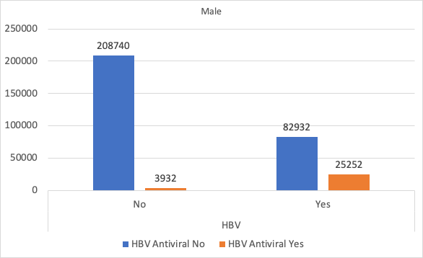
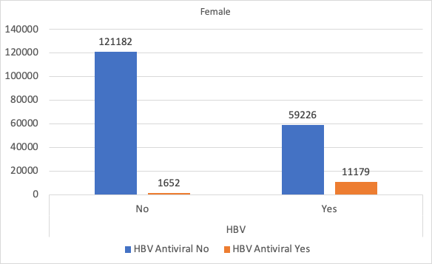
HBV & HBV Antiviral Drug Cross Table
HJ. Kwon
Progress Report
NCC-GCSP

Slide 7
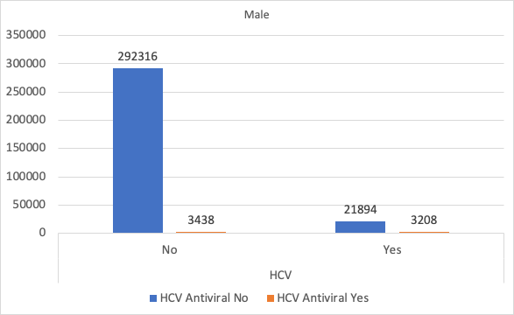
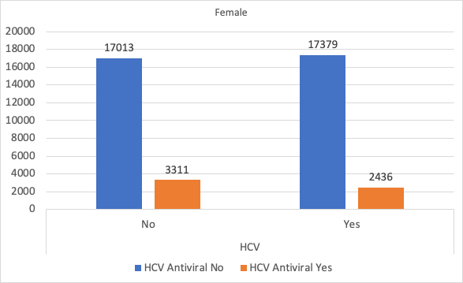
HCV & HCV Antiviral Drug Cross Table
HJ. Kwon
Progress Report
NCC-GCSP

Slide 8
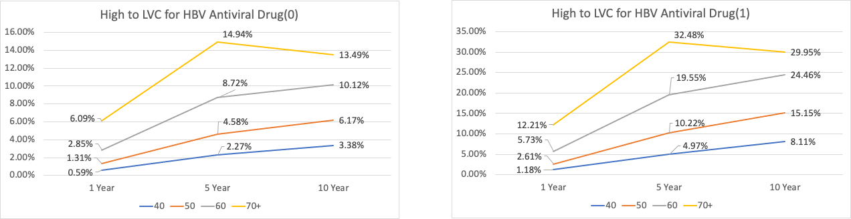
Male Age GRP + HBV + HBV Antiviral Drug
HJ. Kwon
Progress Report
NCC-GCSP

Slide 9
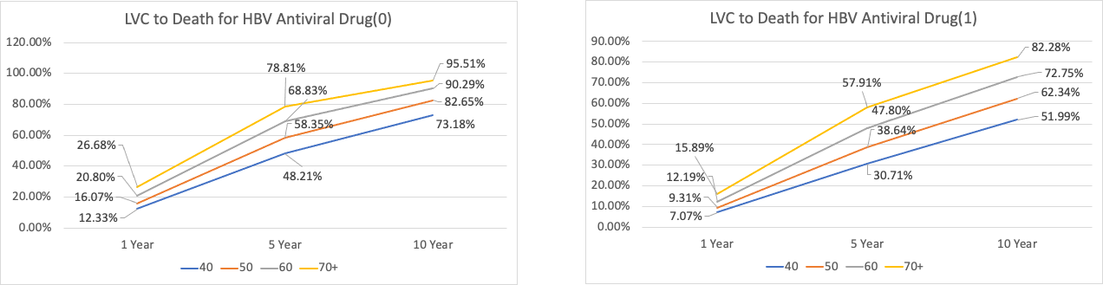
Male Age GRP + HBV + HBV Antiviral Drug
HJ. Kwon
Progress Report
NCC-GCSP

Slide 10
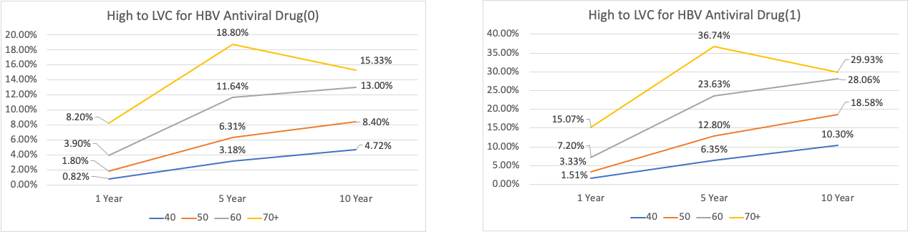
Male Age GRP + HBV + HBV Antiviral Drug + Cirrhosis
HJ. Kwon
Progress Report
NCC-GCSP

Slide 11
Male Age GRP + HBV + HBV Antiviral Drug + Cirrhosis
HJ. Kwon
Progress Report
NCC-GCSP

Slide 12
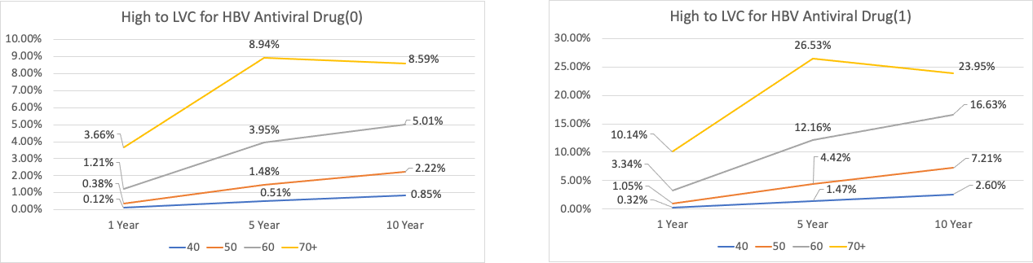
Female Age GRP + HBV + HBV Antiviral Drug
HJ. Kwon
Progress Report
NCC-GCSP

Slide 13
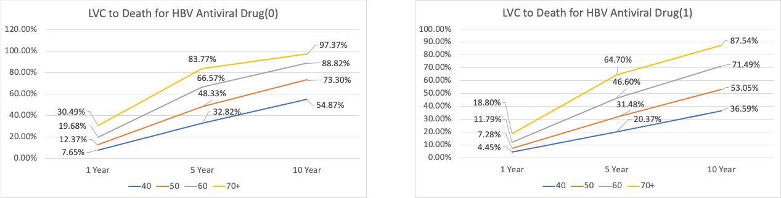
Female Age GRP + HBV + HBV Antiviral Drug
HJ. Kwon
Progress Report
NCC-GCSP

Slide 14
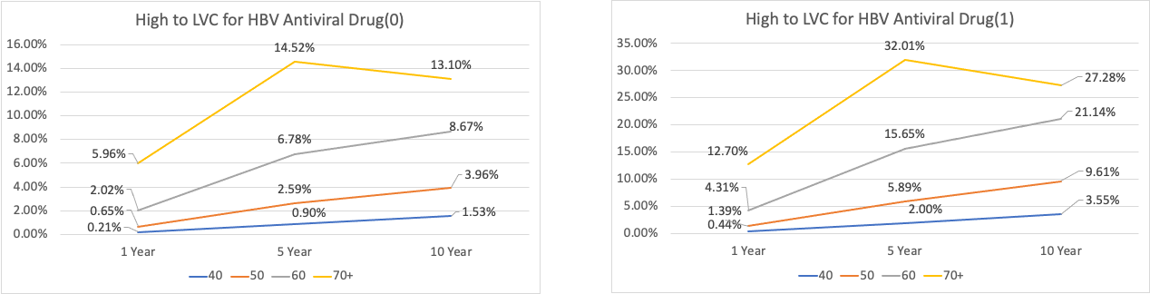
Female Age GRP + HBV + HBV Antiviral Drug + Cirrhosis
HJ. Kwon
Progress Report
NCC-GCSP

Slide 15
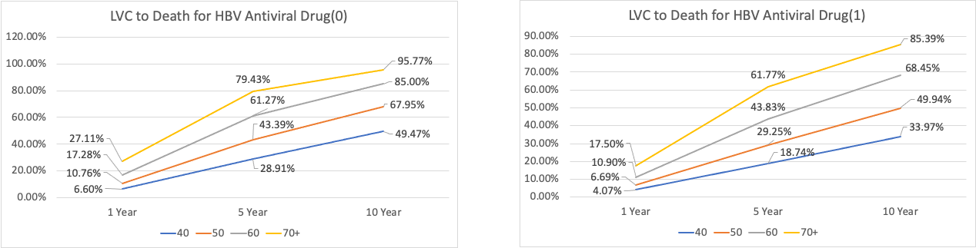
Female Age GRP + HBV + HBV Antiviral Drug + Cirrhosis
HJ. Kwon
Progress Report
NCC-GCSP

Slide 16
Fatty Liver Index
HJ. Kwon
Progress Report
NCC-GCSP

Slide 17
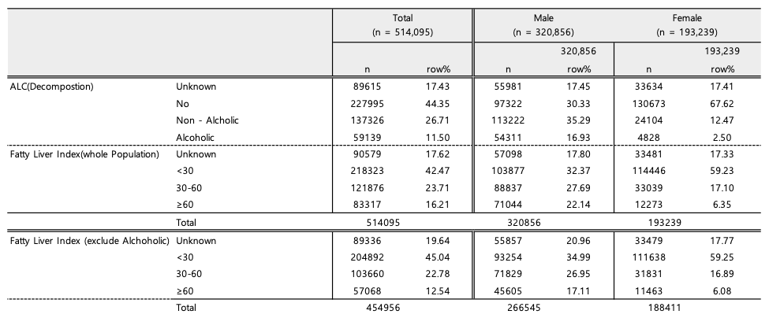
HJ. Kwon
Progress Report
NCC-GCSP

Slide 18
Others Distribution
HJ. Kwon
Progress Report
NCC-GCSP

Slide 19
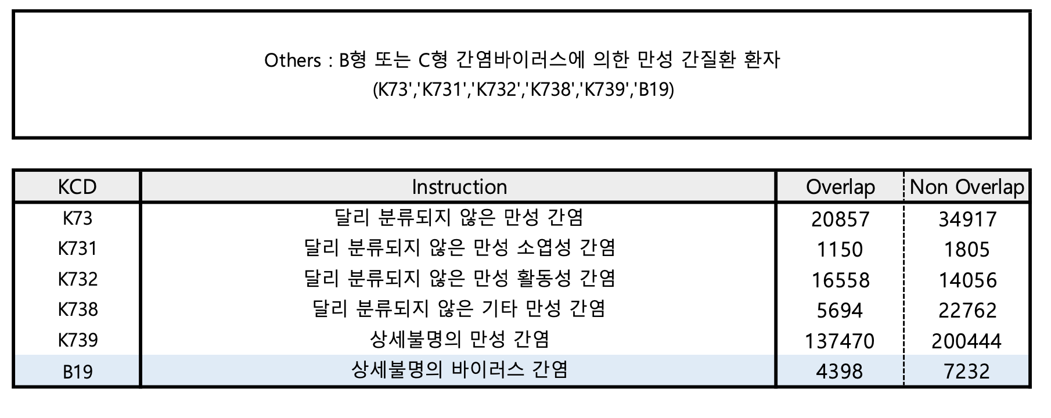
HJ. Kwon
Progress Report
NCC-GCSP

Slide 20
Hepatic Steatosis Index
HJ. Kwon
Progress Report
NCC-GCSP

Slide 21
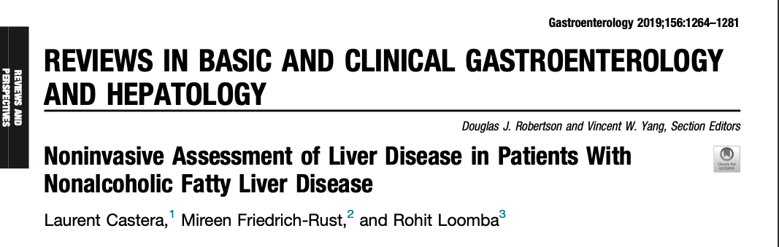
HJ. Kwon
Progress Report
NCC-GCSP

Slide 22
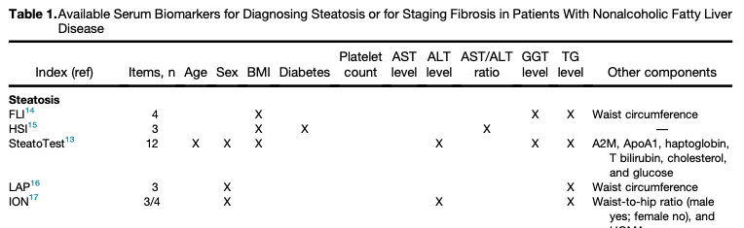
HJ. Kwon
Progress Report
NCC-GCSP

Slide 23
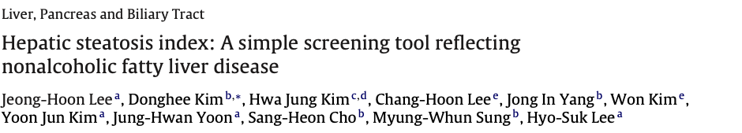
Topic | Devise a simple index of NAFLD
Study Population | 10,724 (5362 cases with NAFLD)
Data Source | Seoul National University Hospital
Variable | AST, ALT, BMI
HJ. Kwon
Progress Report
NCC-GCSP

Slide 24

HSI had an area under receiver-operating curve of 0.812
(95% confidence interval, 0.801–0.824)
t values of <30.0 or >36.0, HSI ruled out NAFLD with a sensitivity of 93.1%, or detected NAFLD with a specificity of 92.4%, respectively.
Of 2692 subjects with HSI <30.0 or >36.0 in the derivation cohort, 2305 (85.6%) were correctly classified
HJ. Kwon
Progress Report
NCC-GCSP

